Slide 1

Principles of Economics
Swagat Kishore Mishra
Lecturer, Dept. of Economics
Email: swagat@bits-goa.ac.in / sayswagat@gmail.com
VOIP: 207 PSRN: 485 CHAMBER: A-301/16
Tel. 0832-2580207 (O) 08879506995 (M)
Lecture-3

Slide 2

Contents
Reconciliation of Lectures 1 & 2
Elasticity of Demand and Supply functions
Basic Lacunae in deriving utility by the Cardinal School
Assignment 1
Assignment 2
Practice Set 1

Slide 3
Reconciliation Lecture-1 and 2
Utility (Marshallian Cardinal Vs. Hicks-Allen Ordinal)
Law of Demand and Supply
Positive and Normative Economics
Micro and Macro Economics
Comparative statics and Comparative dynamics
Indifference curves and Budget constraints

Slide 4
Elasticity of Demand (Supply)
The slope of a linear demand curve is constant, but its elasticity is not.
The price elasticity of demand determines whether the demand curve is steep or flat.
The price elasticity of supply determines whether the supply curve is steep or flat.

Slide 5
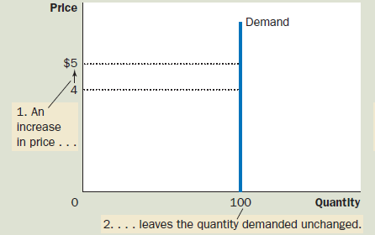
(a) Perfectly Inelastic Demand: Elasticity Equals ‘0’ (Zero)

Slide 6
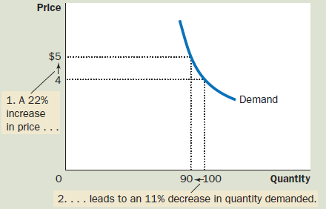
(b) Inelastic Demand: Elasticity Is Less Than 1

Slide 7
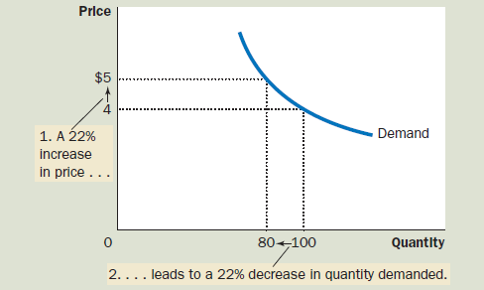
(c) Unit Elastic Demand: Elasticity Equals 1

Slide 8
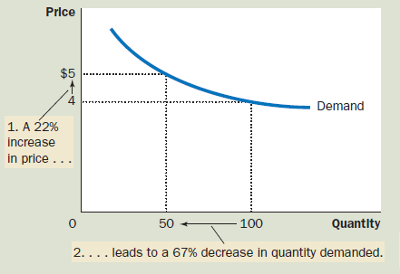
(d) Elastic Demand: Elasticity Is Greater Than 1

Slide 9
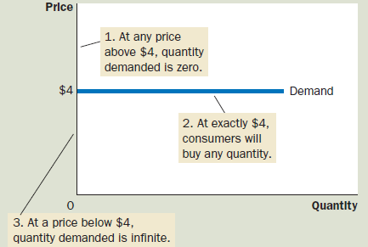
(e) Perfectly Elastic Demand: Elasticity Equals Infinity

Slide 10
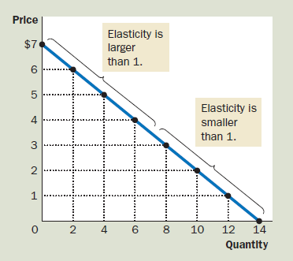
Elasticity of a Linear Demand Curve

Slide 11
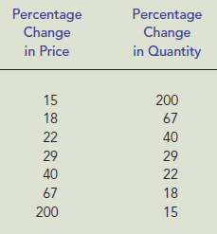
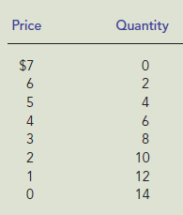
Assignment: 3
Demand Schedule (Supply):
Find Elasticity of Demand and define the type.

Slide 12

Income Elasticity of Demand:
Normal goods have positive income elasticities and
Inferior goods have negative income elasticities.
“A measure of how much the quantity demanded of a good responds to a change in consumers’ income, computed as the percentage change in quantity demanded divided by the percentage change in income”

Slide 13
The Cross-Price Elasticity of Demand
“A measure of how much the quantity demanded of one good responds to a change in the price of another good, computed as the percentage change in quantity demanded of the first good divided by the percentage change in the price of the second good.”

Slide 14
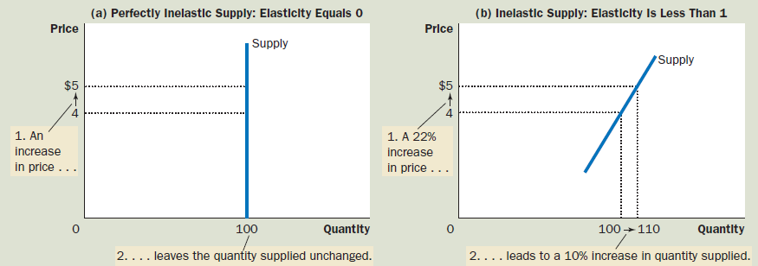
Elasticity of Supply

Slide 15
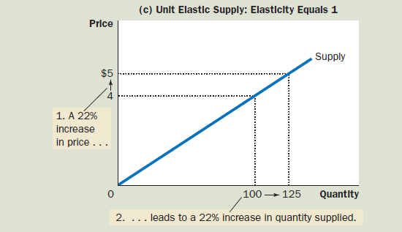

Slide 16
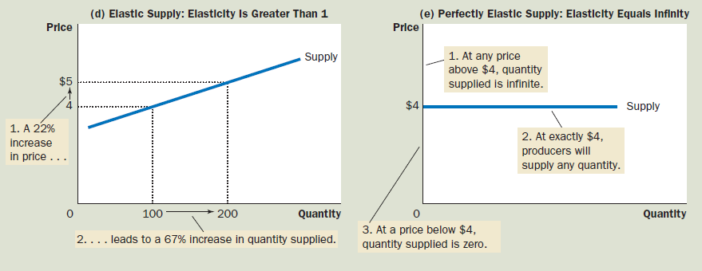

Slide 17
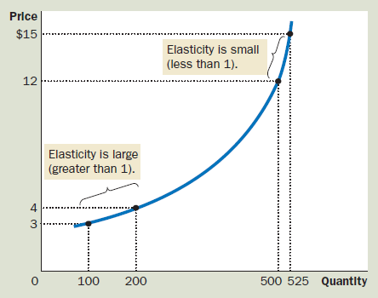

Slide 18
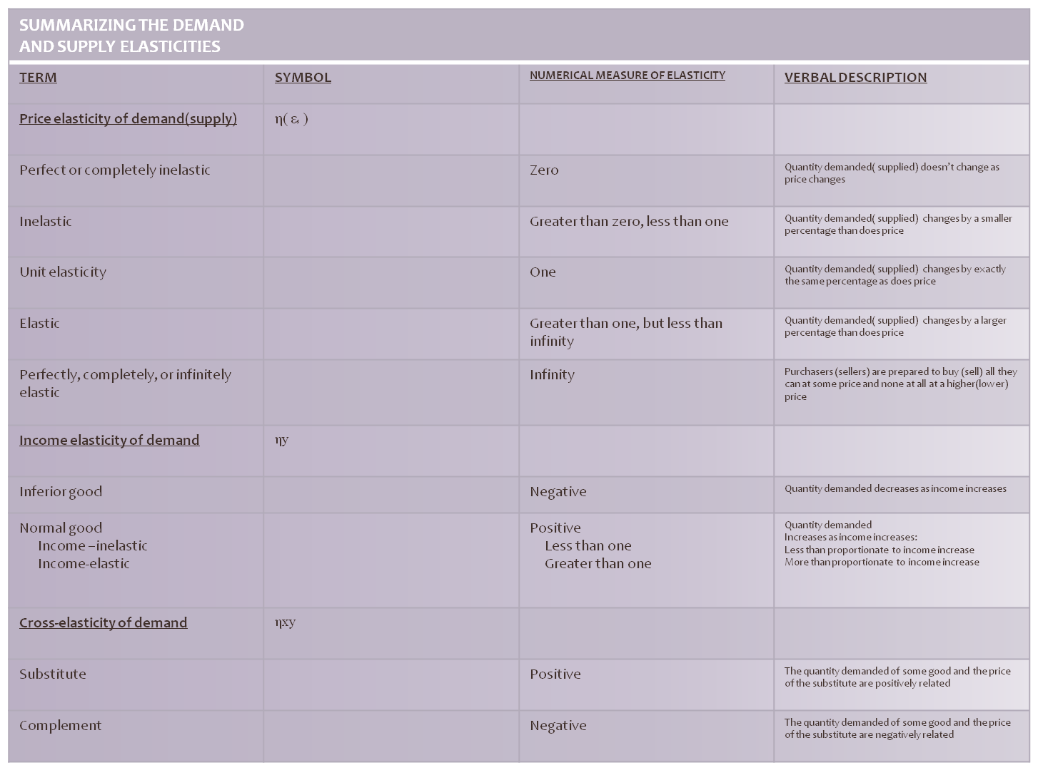

Slide 19
Basic Lacunae in deriving utility by the Cardinal School
Measuring satisfaction quantitatively is a complex error.
Walras suggestion of Utils as subjective criteria for preference ordering is a BLITHE-exaggerated.
Assuming constant utility of Money is an unrealistic simplification.
Diminishing Marginal Utility axiom is psychological understanding not a rule of thumb.
CARDINAL SCHOOL: Gossen, Jevons, Walras and Marshsall.
ORDINAL SCHOOL: Hicks and Allen

Slide 20
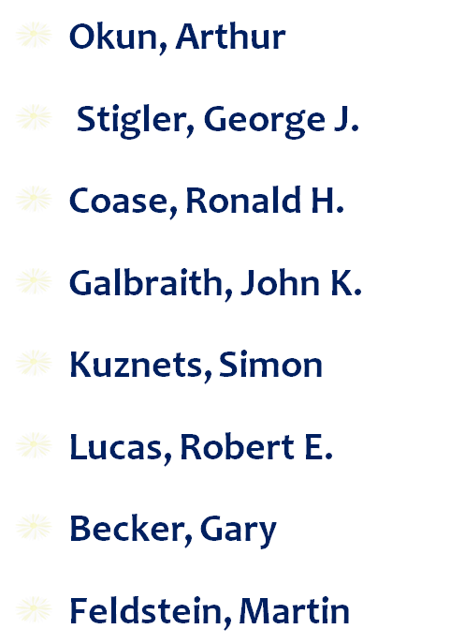
ECONOMISTS for POE
Keynes, John Maynard
Smith, Adam
Friedman, Milton
Ricardo, David
Marx, Karl
Malthus, Thomas
Marshall, Alfred
Schumpeter, Joseph

Slide 21
Next: Lecture-4-10
Opportunity Cost and Production Possibility Frontier/Curve
Consumer Surplus and Producer Surplus
Marginal Rate of Substitution (MRS) and Marginal Utility (MU)
Economic Surplus
Dead Weight Loss
Deriving Demand Curve from Indifference Curve
Deriving Total Revenue Curve from Demand Curve
Demand Function and Indifference Curve for different types of Commodities/Economic-goods
Elasticity of Demand and Elasticity of Supply
Income Effect and Substitution Effect
Slutsky Theorem
Revealed Preference Theory

Slide 22
Thanking
BITS PILANI, K.K.BIRLA GOA CAMPUS
Under the aegis of
Department of Economics
Dr. Mridula Goel (HOD)
Dr. Debashish Pattanaik
Dr. Aswini Kumar Mishra
Dr. Kubendran N.
Dr. Indranil De
Ms. Ambili K.
Mr. Swagat Kishore Mishra

